Slide 1
CAPSTONE PROJECT
SENTIMENT ANALYSIS
Presented By :
1. Student Name :Veesam Naveen
2.College Name : Aditya College of Engineering,Surampalem
3.Department : Electronics and Communication Engineering(ECE)

Slide 2
OUTLINE
Problem Statement (Should not include solution)
Proposed System/Solution
System Development Approach (Technology Used)
Algorithm & Deployment
Result
Conclusion
Future Scope
References

Slide 3
PROBLEM STATEMENT
Develop a sentiment analysis model to classify reviews as positive or negative.
Preprocess the review text using techniques such as lowercasing , removing stop words and lemmatization

Slide 4
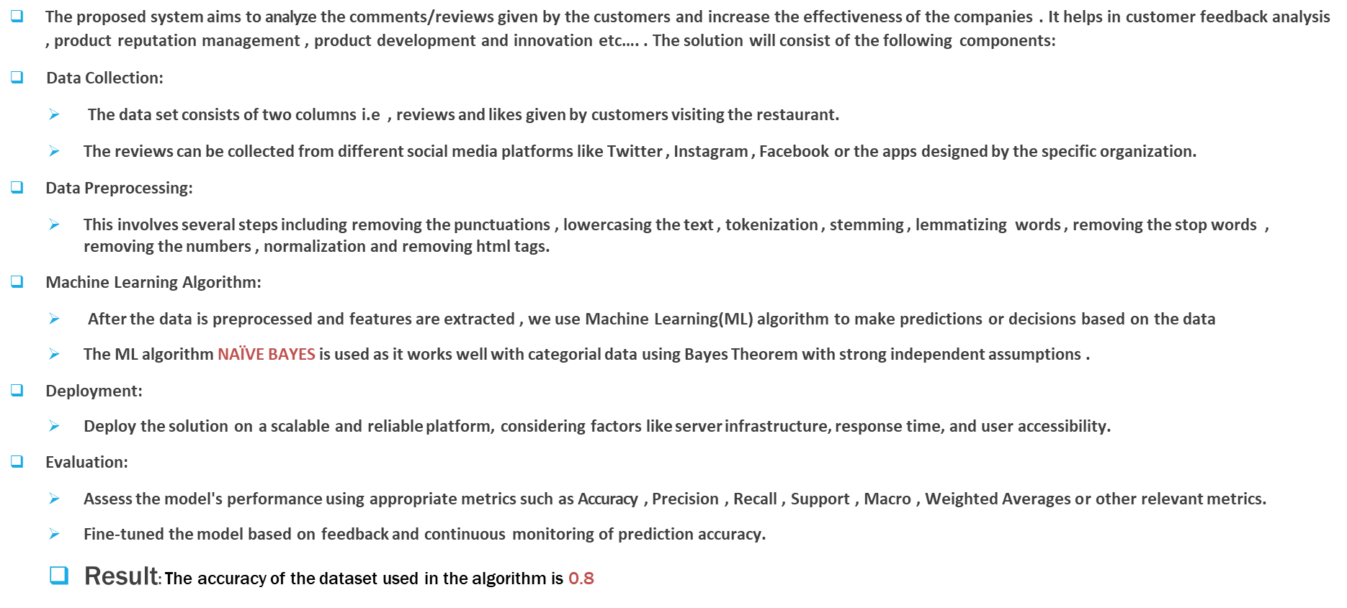
PROPOSED SOLUTION

Slide 5
SYSTEM APPROACH
This section outlines the overall strategy and methodology for developing and implementing the AI and ML project on Sentiment Analysis.
System requirements
Hardware Requirements:
Core i5/i7 processor
At least 8 GB RAM
Software Requirements:
Python 3.x
Anaconda Distribution
NLTK Toolkit
UNIX/LINUX Operating System.
Library required to build the model
pandas
nltk
seaborn and matplotlib
sklearn

Slide 6
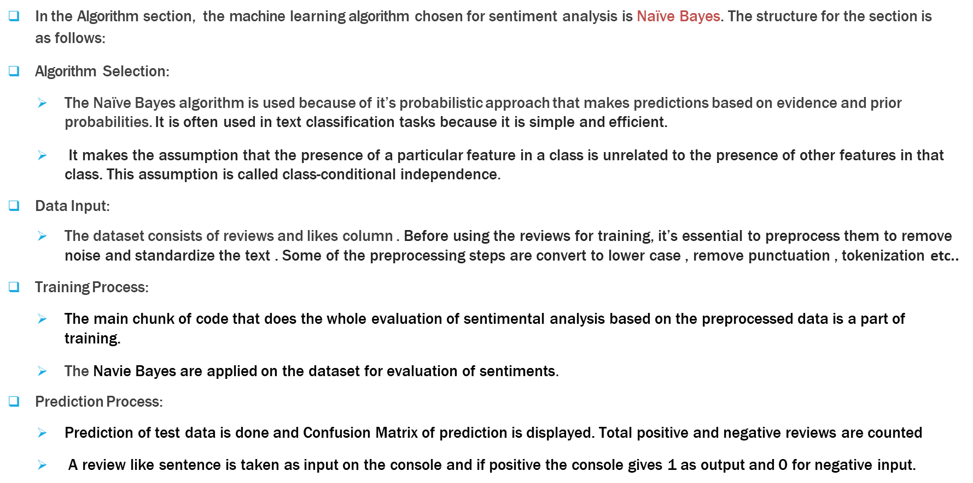
ALGORITHM & DEPLOYMENT

Slide 7
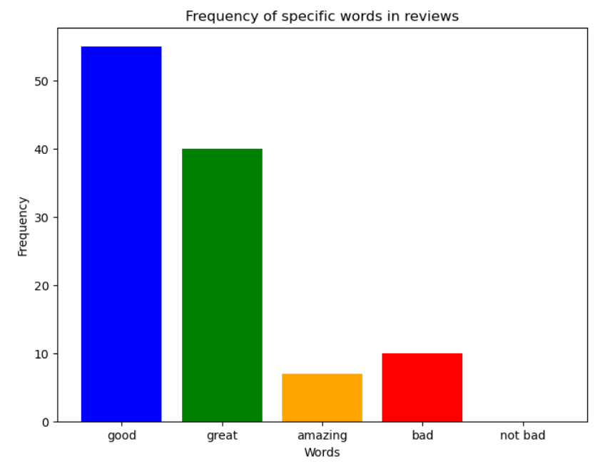
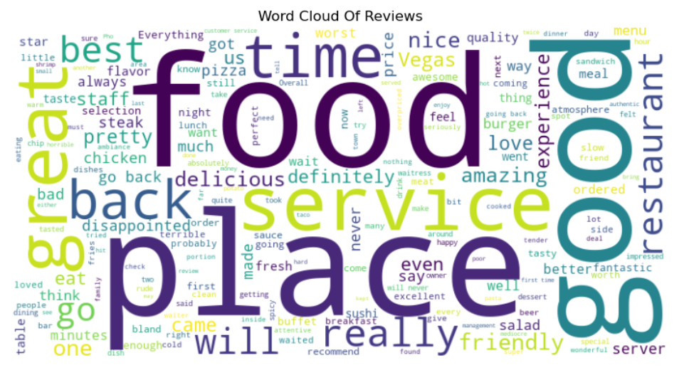
RESULT
The above bar graphs shows the numbers of times the specific words are used in the reviews
The image indicates that the words such as food,place ,good are used in high frequency in the reviews given by customers

Slide 8
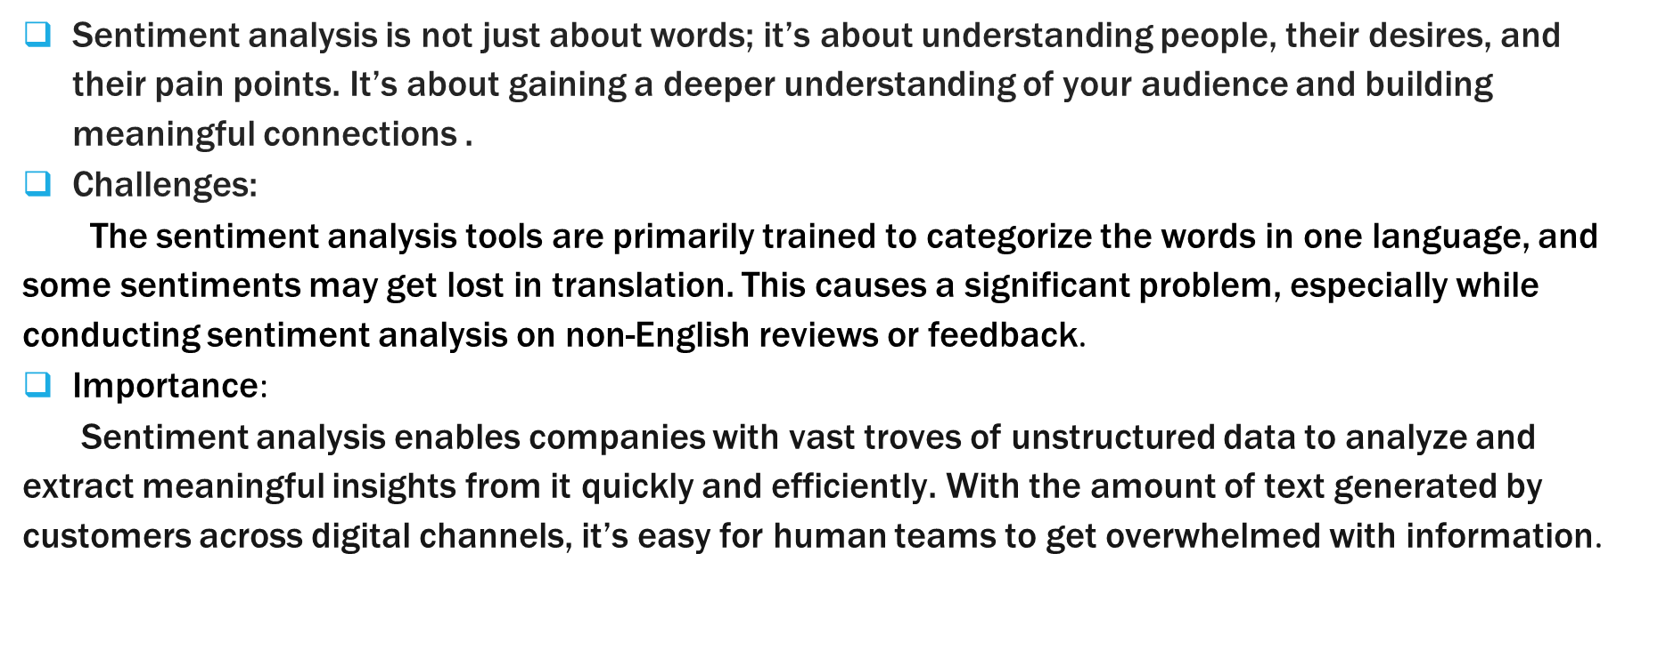
CONCLUSION

Slide 9
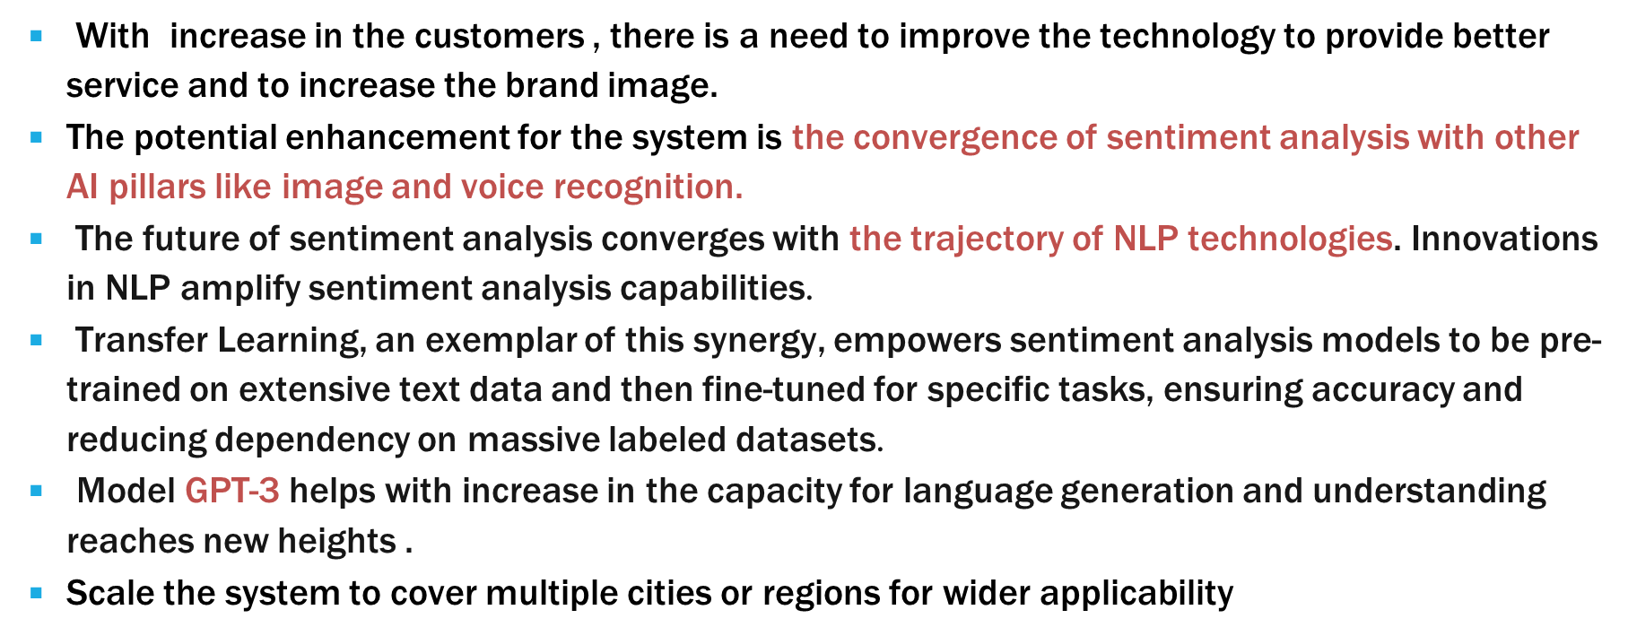
FUTURE SCOPE

Slide 10
REFERENCES
Online Sources :
Google
Chatgpt
Github : https://github.com/Naviden/Sentiment-Analysis-in-Python
Geeksforgeeks : https://www.geeksforgeeks.org/what-is-sentiment- analysis/
IBM Website : https://www.ibm.com/topics/sentiment-analysis
Articles : https://www.ibm.com/topics/artificial-intelligence
Youtube
edureka

Slide 11
THANK YOU

